Slide 1

G2M insight for Cab Investment firm
Company Name : XYZ

Slide 2
INFO’S
XYZ is a private firm in US. Due to remarkable growth in the Cab Industry in last few years and multiple key players in the market, it is planning for an investment in Cab industry and as per their Go-to-Market(G2M) strategy they want to understand the market before taking final decision.
Objective : Provide actionable insights to help XYZ firm in identifying the right company for making investment.
Cab Companies:
Yellow Cab
Pink Cab

Slide 3
DATASET
Below are the list of datasets which are provided for the analysis:
Cab_Data.csv – this file includes details of transaction for 2 cab companies
Customer_ID.csv – this is a mapping table that contains a unique identifier which links the customer’s demographic details
Transaction_ID.csv – this is a mapping table that contains transaction to customer mapping and payment mode
City.csv – this file contains list of US cities, their population and number of cab users

Slide 4
Eda
The analysis has steps of;
-Data understanding
-Data preparation
-Data cleaning
-Data visualization
-Coming up with different hypothesis

Slide 5
hypothesıs
Hypothesis:
Yellow cab company has the higher profit according to the years.
Yellow cab company has the most profit.
How the genders distribute according to cab companies
Card as a payment method is mostly used.
New York is the city that the companies get the most profit.
Pink cab company customers mostly use cards.
Profit increases each year for both companies.
As KM travelled increases , price charged also increases.
There ıs dıfference between card or cash payıng on profıt.
There is difference between genders for profit in both companies.
There is difference between ages for profit in both companies.

Slide 6
EXPLORATORY DATA ANALYSIS

Slide 7
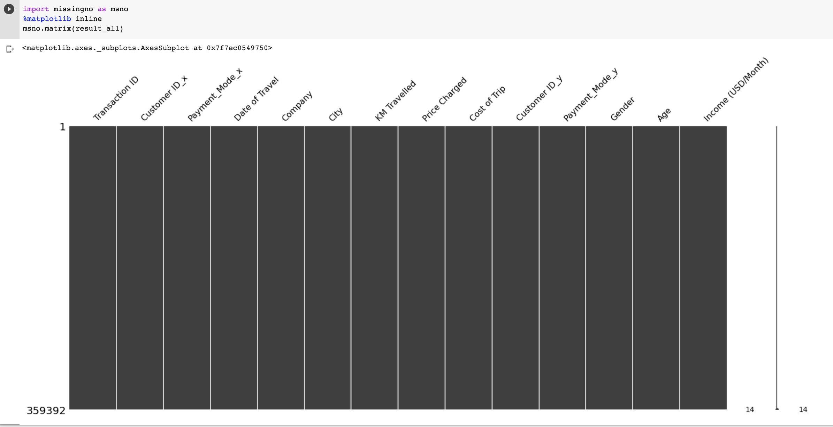
As we can see in the graph , there is no nan/null values in the dataset.

Slide 8
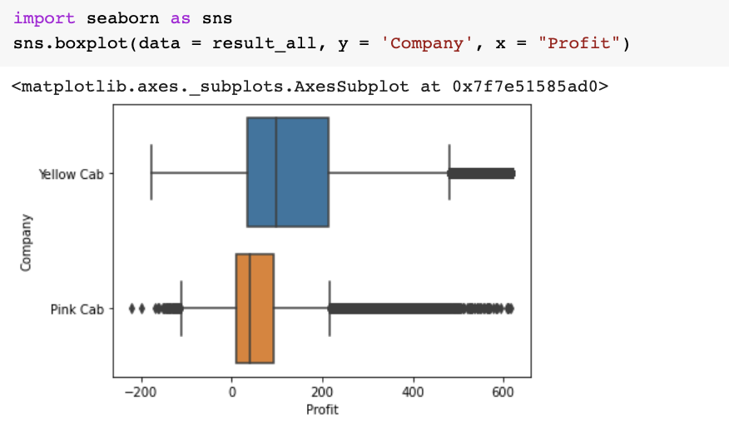
There were no spesific outliers in our most useful features, company and profit.

Slide 9
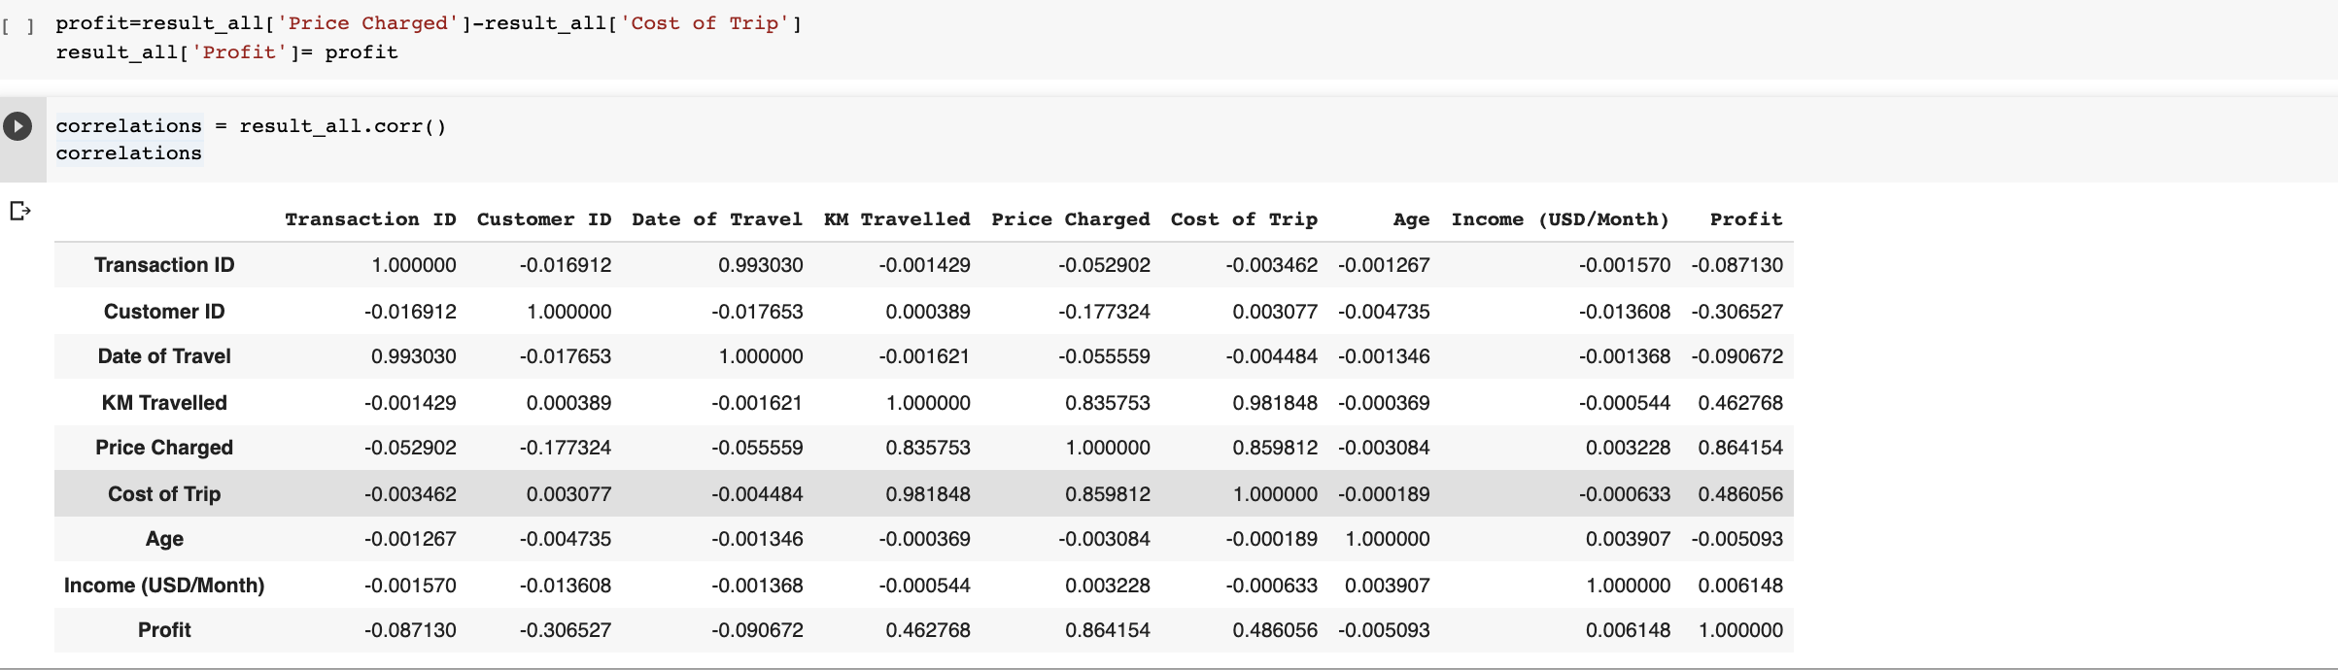
CORRELATION SKETCH FOCUSING PROFIT
As we can see in the correlation sketch , profit is most correlated to cost of trip, price charged,KM travelled.

Slide 10
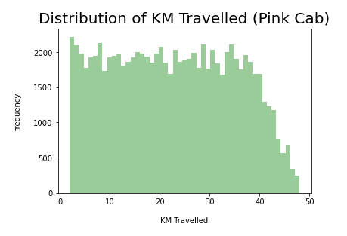
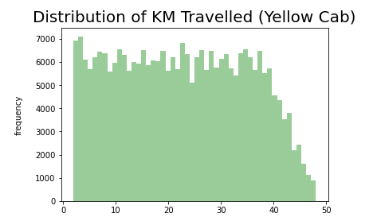
KM TRAVELLED FREQUENCIES
Both are between 2-48 km.

Slide 11
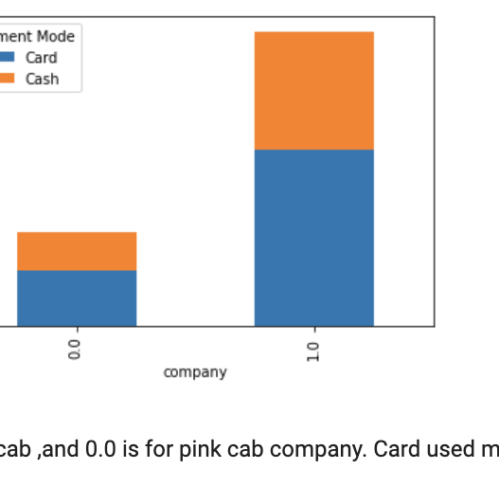







CARD OR CASH
As we can see in the figure both pink and yellow cab customers prefer card over cash.
Pink cab
Yellow cab

Slide 12
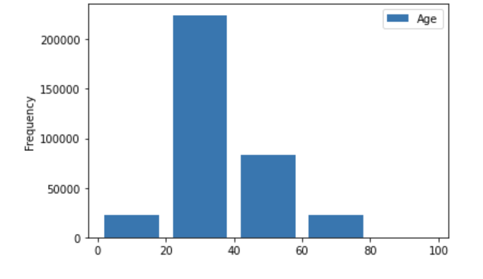
AGE DISTRIBUTION GRAPH
Users in age gap 20-40 uses cabs more common.

Slide 13

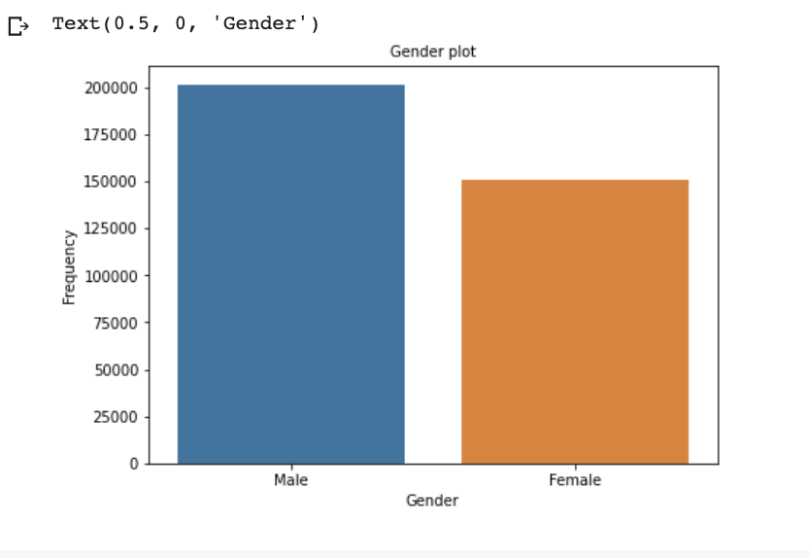
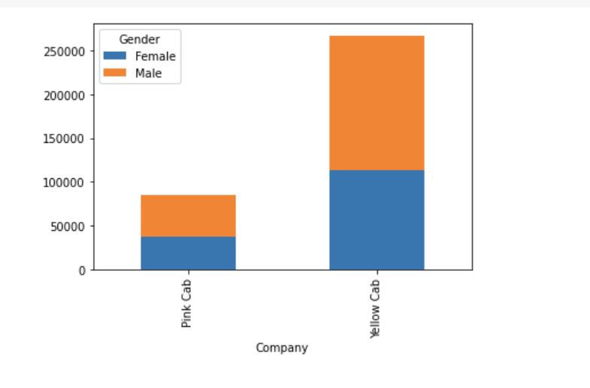
GENDER DIST ACCORDING TO COMPANIES
Instead of women, men use cabs more common . Males are more common in yellow cab and there is not a significant difference between gender in pink cab.

Slide 14
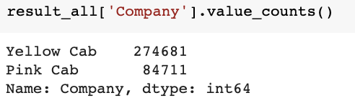
NUMBER OF CABS PER COMPANY

Slide 15
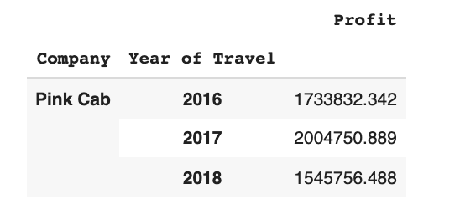
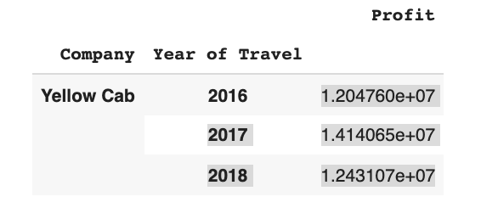
PROFITS OF COMPANIES’
Yellow cab has a significant difference in profit compared to pink cab.

Slide 16
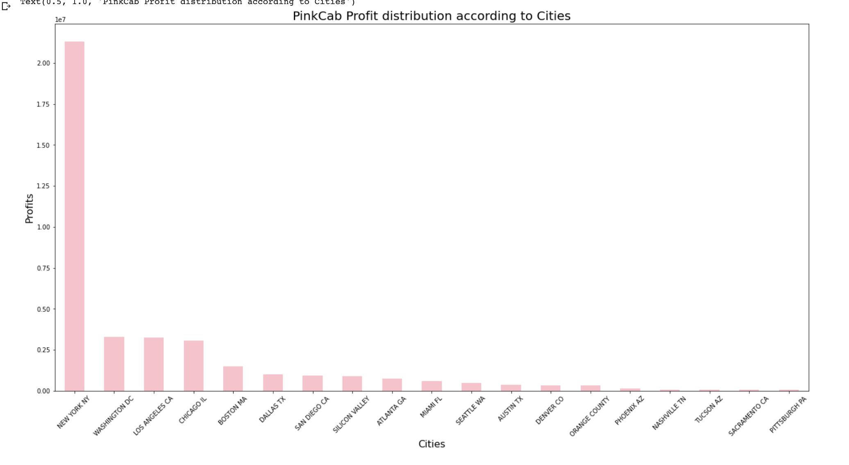

PINK CAB DISTRIBUTION ACCORDING TO CITIES

Slide 17
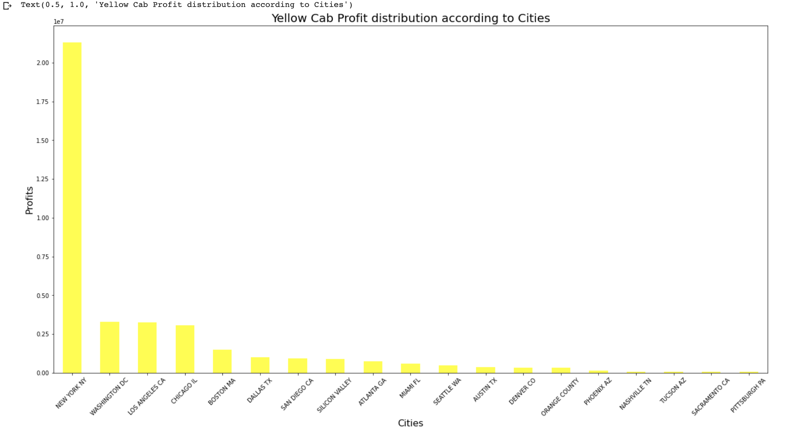
YELLOW CAB DISTRIBUTION ACCORDING TO CITIES

Slide 18
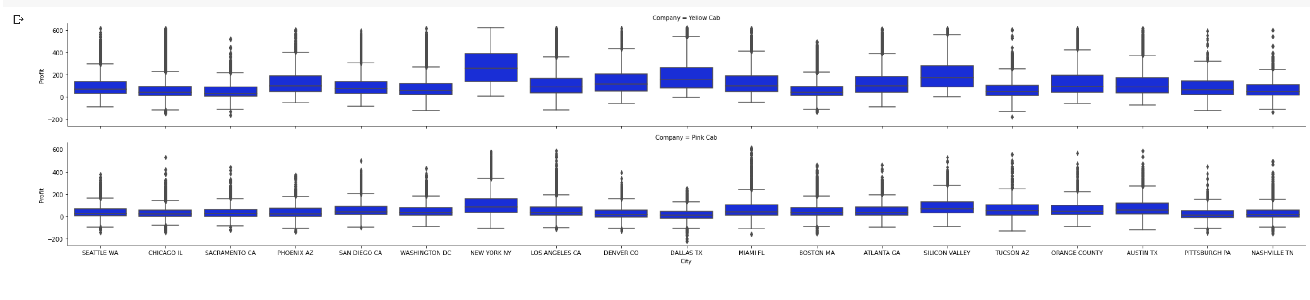
PROFIT ANALYSIS TOWARDS CITIES FOR BOTH COMPANIES

Slide 19
CAB DISTRIBUTION ACCORDING TO CITIES
As we can see in the box plots,
New York,
Washington DC,
Los Angeles
are the most popular cities which cabs are used in both cities.

Slide 20
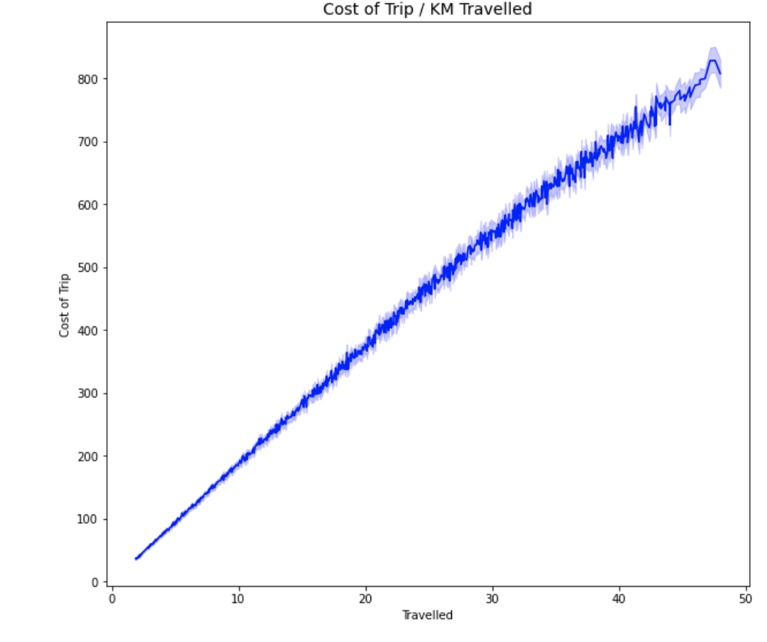
COST OF TRIP –KM TRAVELLED CORRELATION
They are linearly correlated but the slope is slightly decreased towards 50km.

Slide 21
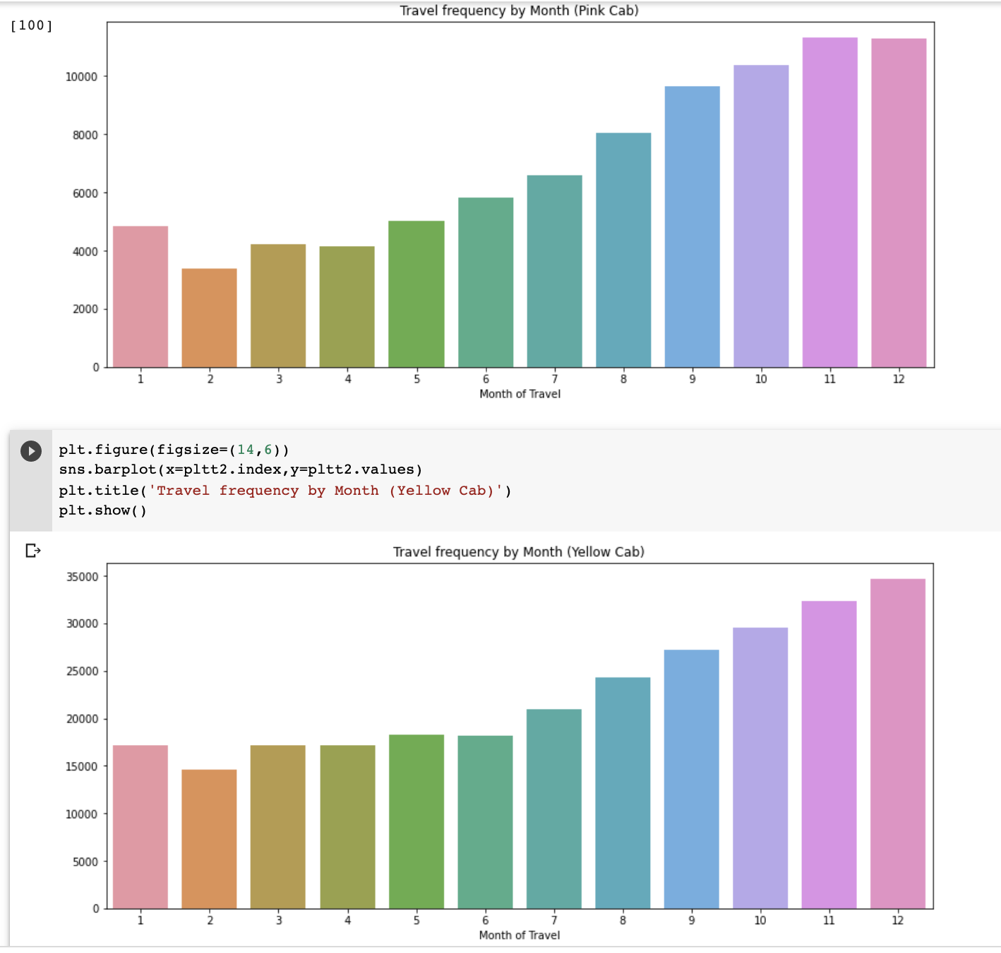
MONTHLY FREQUENCIES FOR PER COMPANY
At the end of each year travel frequencies for both cab companies increase but each month yellow cab company has a significant higher frequency than pink cab.

Slide 22
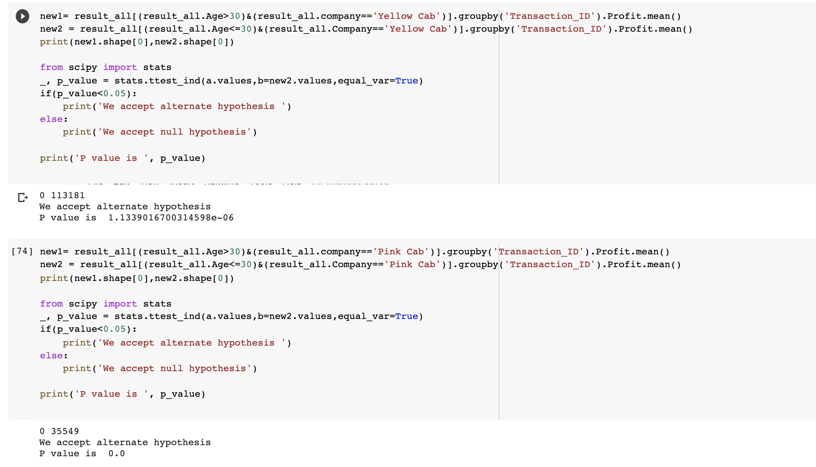
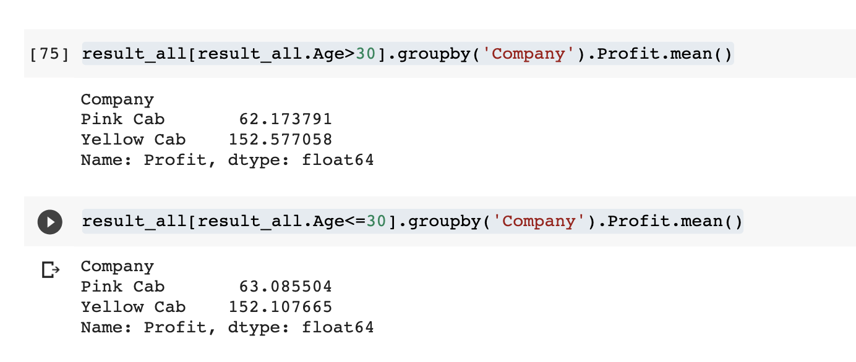
HYPOTHESIS:There is difference between ages for profit in both companies
For both age groups in both companies it does make a difference for gaining profit.In both companies age group which >30 has more contribution to profit.

Slide 23
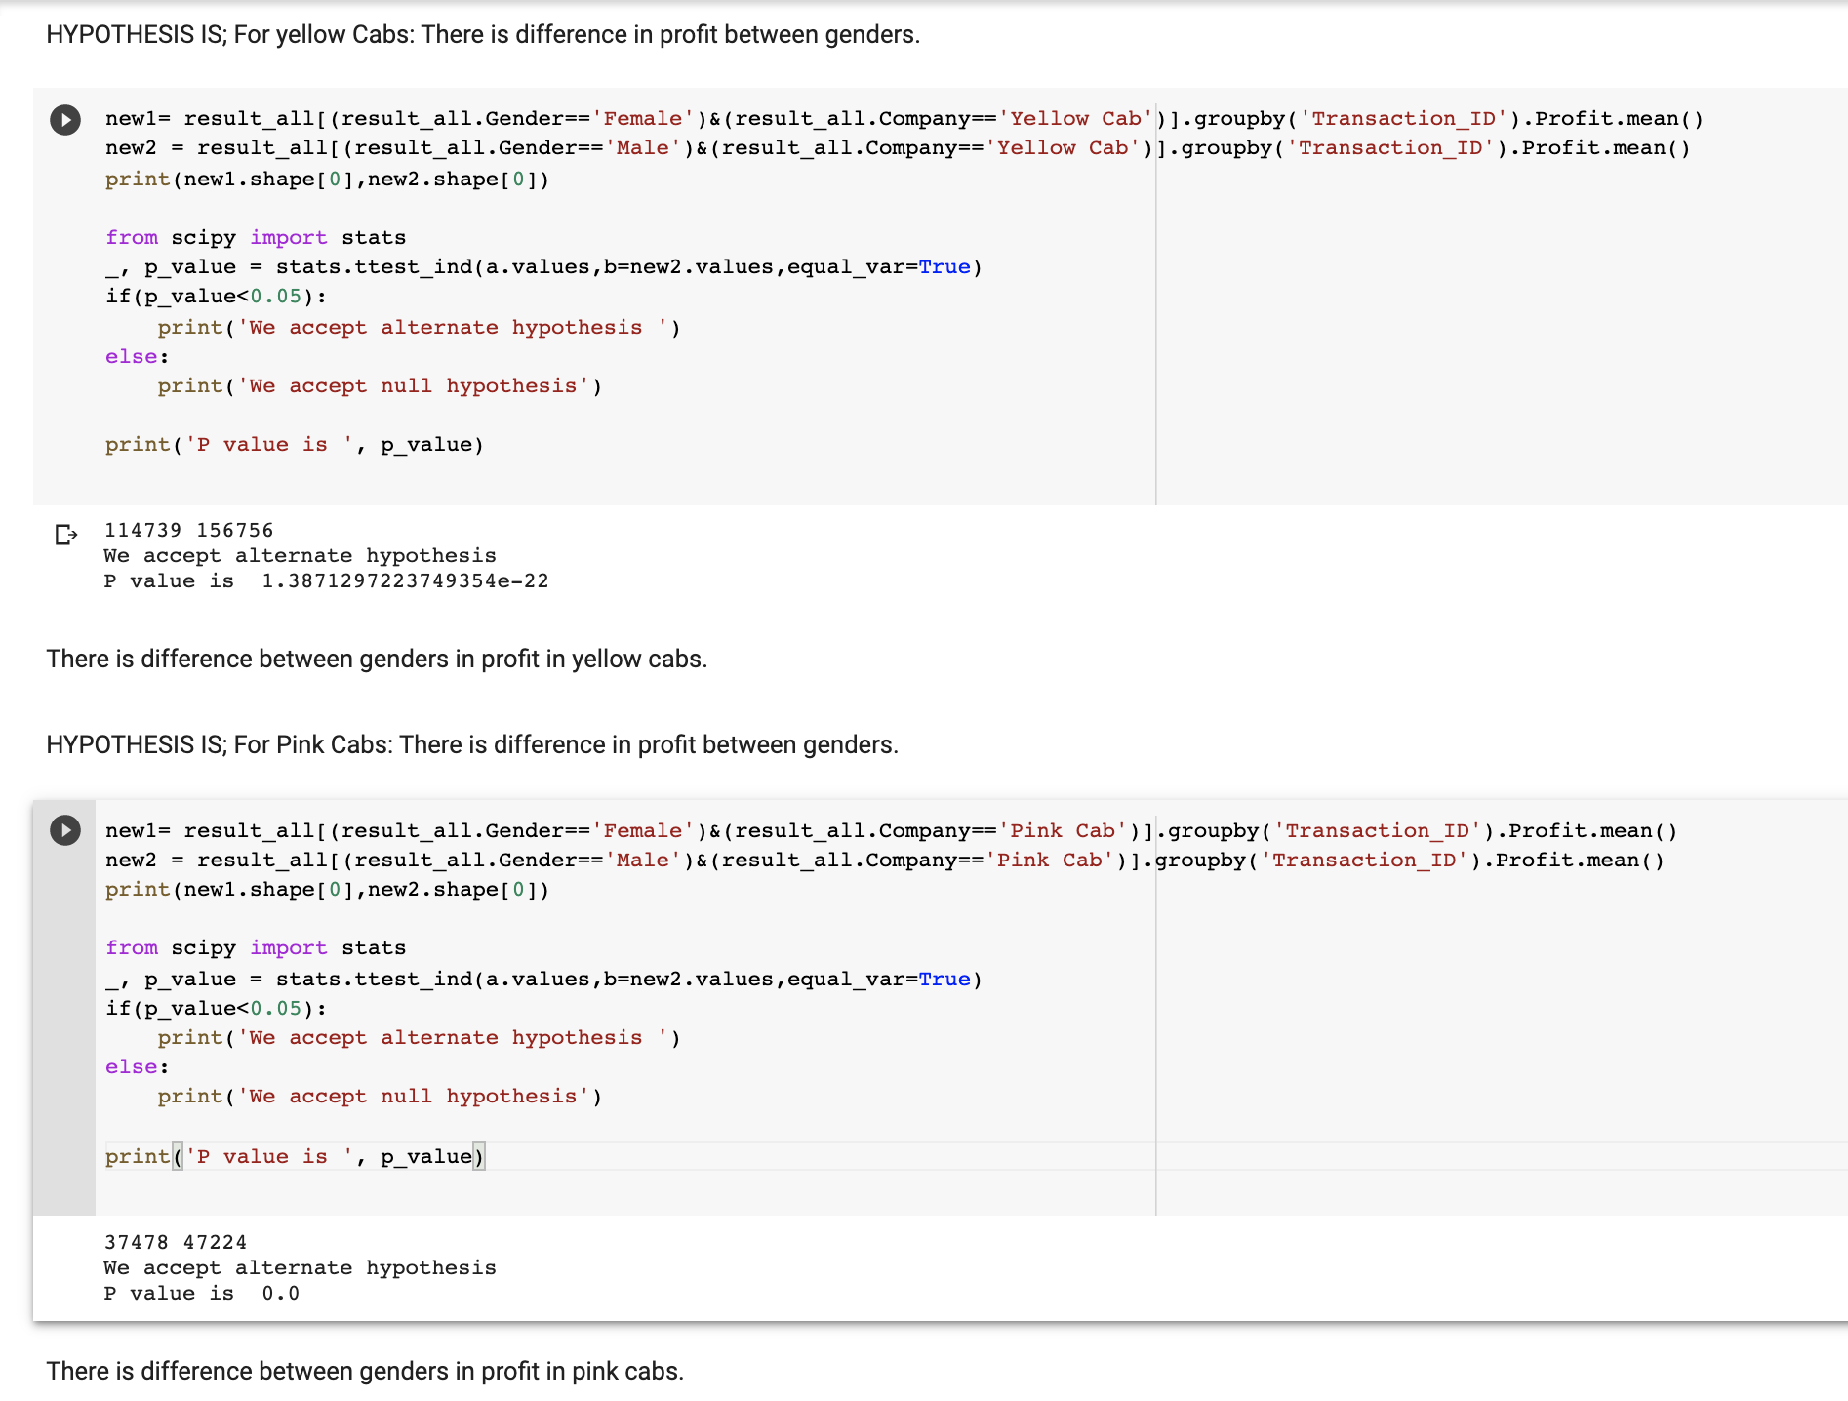
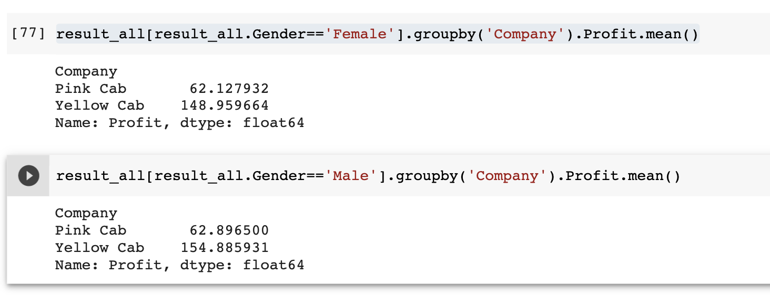
HYPOTHESIS: There is difference between genders for profit in both companies.
The gender difference effect gained profit for both companies.Males has more contribution to profit in both companies.

Slide 24
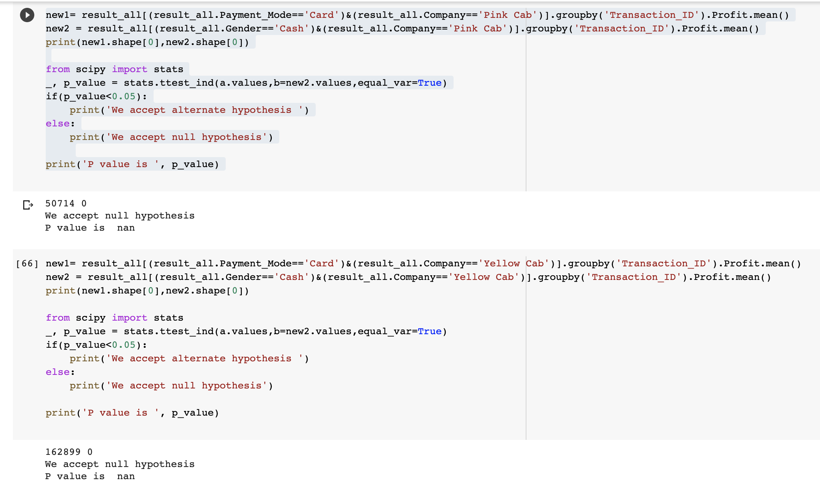


HYPOTHESIS: There ıs dıfference between card or cash payıng on profıt.
There is no difference,no significant effect of paying with card or cash on profit as we can see in p values ,they’re null,we don’t reject the null hypothesis.

Slide 25
EDA recommendation & hypothesis results¶
According to Age: Customers’ age are generally between 20-40 at both companies.
According to Gender: In both companies number of males are always higher than females.There is not a significant difference but total customer number is always higher in yellow cab company.
According to Users: Yellow Cab company has around 3 times the number of customers than Pink Cab company has.
According to Payment Method: Card is used more than cash at both companies.

Slide 26
Yellow company has higher profit than Pink cab company every year.
Again yellow company has the highest total profit.
Genders have not a spesific distribution among companies,but in both males are higher.
Profit doesn’t increase over years, for example in 2017 Pink Cab has higher profit than 2018.
Profit is correlated with gender, not correlated with payment method.
I would prefer YELLOW CAB COMPANY over PINK CAB COMPANY.

